Slide 1


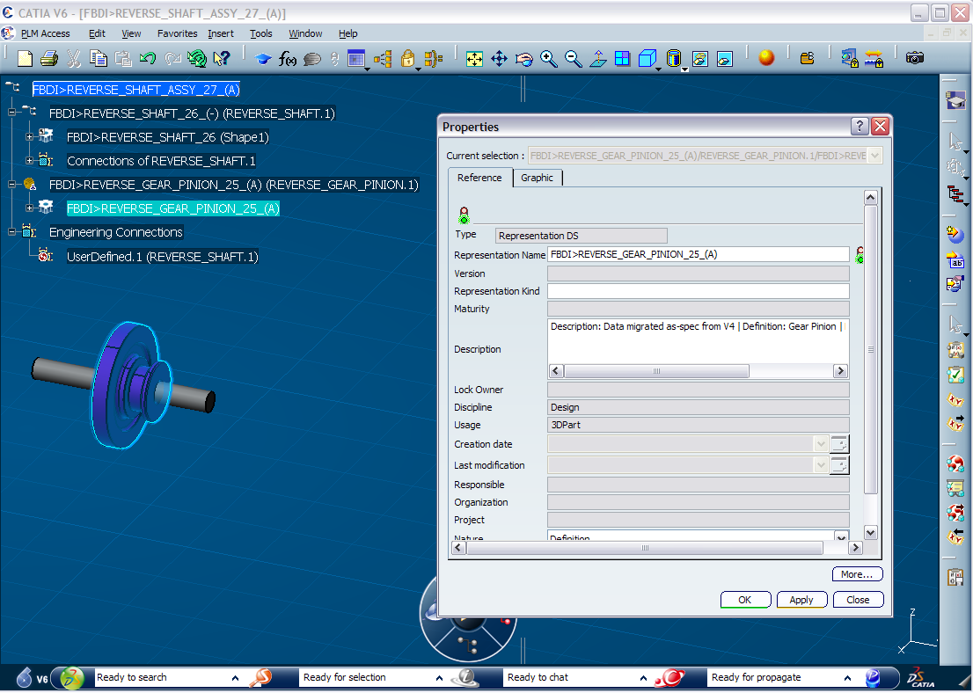
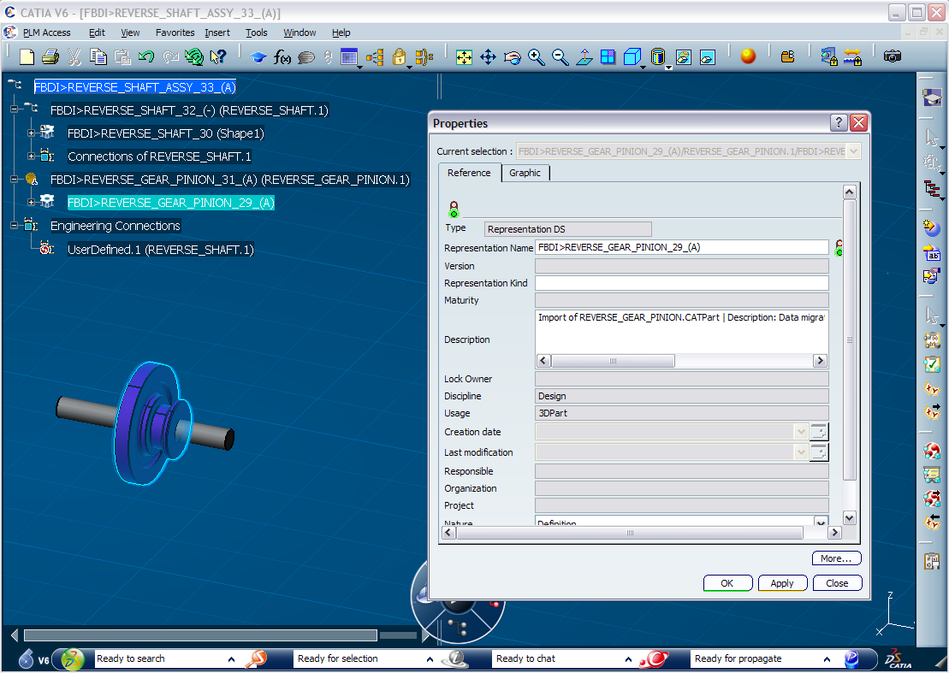
Exercise XXX (Customize your BL for FBDI)
Recap Exercise
10 min
Object
In this exercise, you will learn how to create and modify the Business Logic for FBDI to customize V6 attributes during the import operation
  You will set a customized environment
  You will add in the description attribute the name & type of the original file
Before
After
Notes:
Copyright DASSAULT SYSTEMES

Slide 2
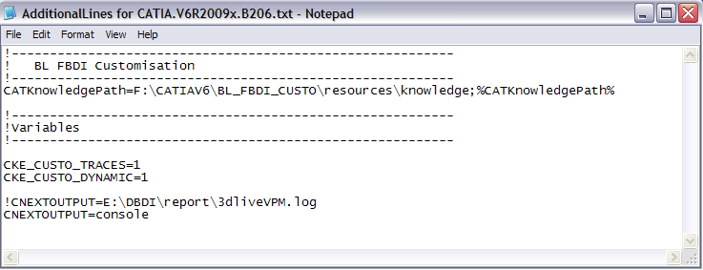
Environment Set up for Business Logics customization
  Create a folder “MyCusto” to copy the “resources” directory
  Customize the environment file
  Add in your environment file (ex :CATIAV6R2009x.B206.txt), the following Line
  CATKnowledgePath=C:\MyCusto\resources\knowledge;%CATKnowledgePath%
  During debugging, add in your environment file, the following variables for Business Logics
  CKE_CUSTO_TRACES=1 (To activate traces)
  CKE_CUSTO_DYNAMIC=1 (To allow change during the same session)
  CNEXTOUTPUT=console (or CNEXTOUTPUT=C:\...\OutputFile.log)
  =>To add these lines you can copy the lines included in the AdditionalLines*.txt file and modify the Path
Notes:
Copyright DASSAULT SYSTEMES

Slide 3
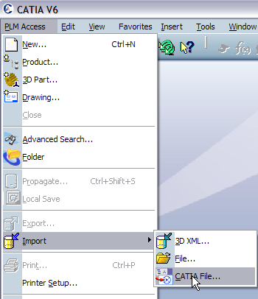

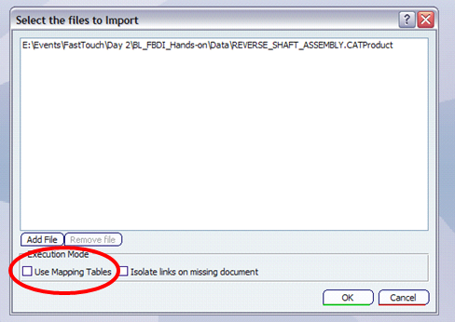
Test your environment 1/2
  Import V5 & V4 data : REVERSE_SHAFT_ASSEMBLY.CATProduct
    Do not use the “Use Mapping Tables” option
Notes:
Copyright DASSAULT SYSTEMES

Slide 4
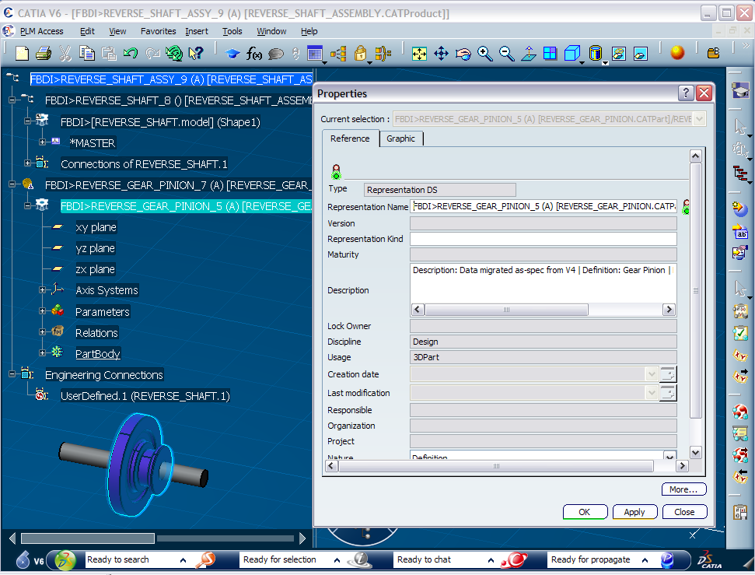
Test your environment 2/2
    Do not save or propagate the result
  If error, you have to look on 2nd window of CNEXT
Notes:
Copyright DASSAULT SYSTEMES

Slide 5
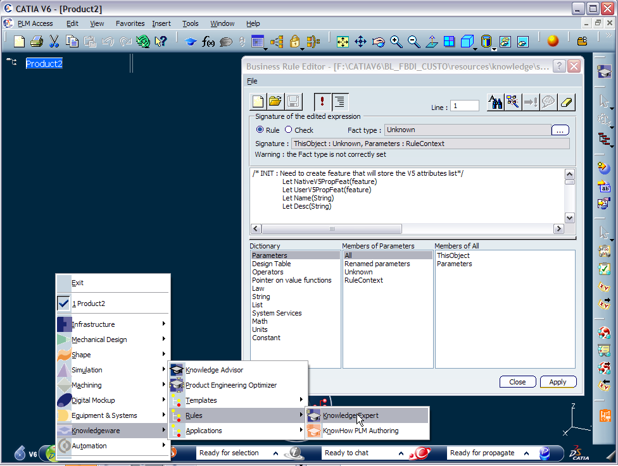
Modify your BL 1/3
Close the Imported data without saving
Open a New Product
Open the Knowledge Expert Workbench
Launch the Business Rule Editor
Open the CUST_FBDI_Import.CATRule
Notes:
Copyright DASSAULT SYSTEMES

Slide 6
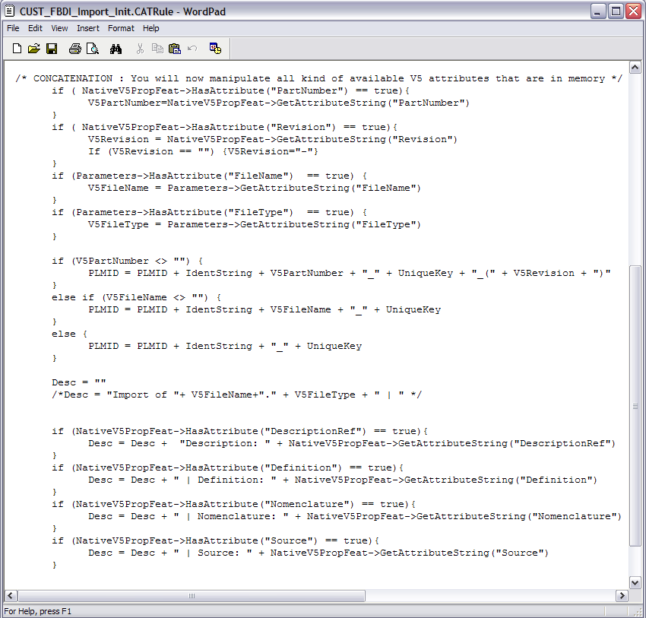
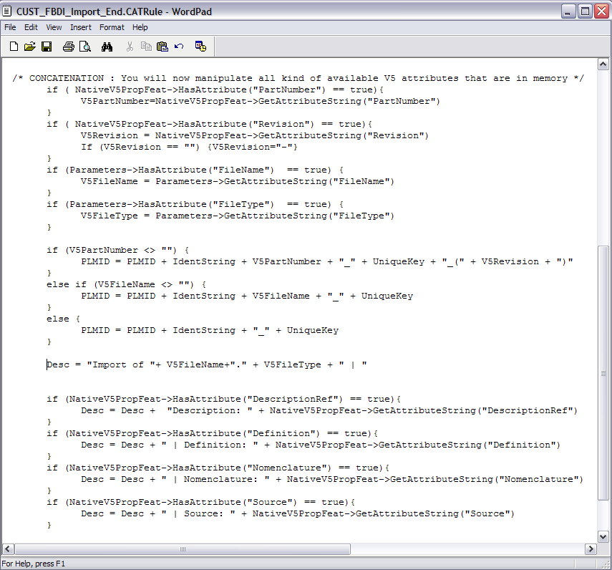
Modify your BL 2/3
  Modify the BL rule with changing the content of the description attributes
Notes:
Copyright DASSAULT SYSTEMES

Slide 7
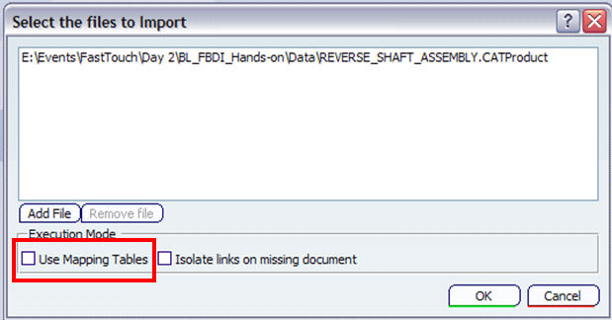
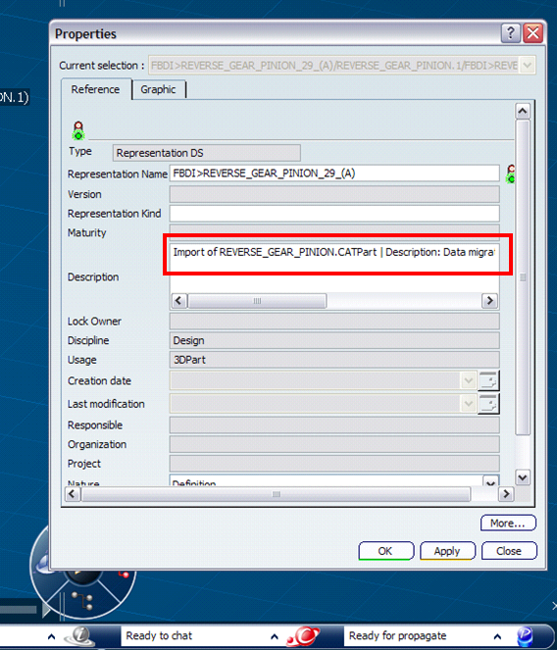
Modify your BL 3/3
  Open Import V5 & V4 data : REVERSE_SHAFT_ASSEMBLY.CATProduct
    Do not use the “Use Mapping Tables” option
    Do not save or propagate the result
Notes:
Copyright DASSAULT SYSTEMES

